Slide 1

Statistical and Predictive Modeling I (DATA 1204-02) Final Project
Name: Maharshi Mehta(100799054)
Professor: Ritwick Dutta

Slide 2

Description Of The Research
We have information on the personal characteristics of household spending that Mr John has gathered here. 1344 observations, 6 independent variables, and 1 dependent variable are all present.
John wants to determine whether smoking has an impact on expenses using a linear regression model.
John also wishes to determine, via the use of a multivariate regression model, how each independent variable influences the cost of the household.

Slide 3
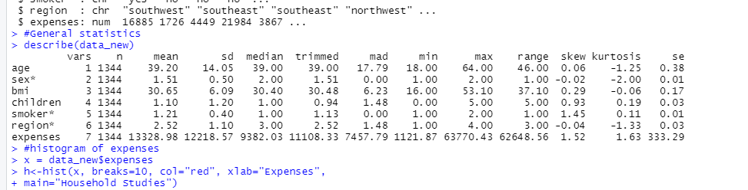
Basic Statistics
Output from code
Mean: The 1344 observations show that the average age is 39.20 and the mean for the sex is 1.51, indicating that the number of men and females in the data is not equal. Additionally, the averages for BMI, children, smokers, and region are respectively 30.65, 1.10, 1.21, and 2.52. The average cost of living is $13328.98.
Standard Deviation: Age, Sex, BMI, Children, Smokers, and Region all had standard deviations of 14.05, 0.50, 6.09, 1.20, 0.40, and 1.10, respectively. The expenses have an SD of 12218.57.
Median: Age, Sex, BMI, Children, Smokers, and Region all had Median of 39.00, 2.00, 30.40, 1.00, 1.00, and 3.00, respectively. The expenses have a median of 9382.03.
Minimum and Maximum: In this statistic, the minimum age is 18 and the maximum age is 64. According to the statistics, the subject's BMI ranges from 16,00 to 53,10 at its lowest point. A minimum of 0 and a maximum of 5 are assigned to the parent. The smoker's minimum and maximum are 1.00 and 2.00. Region minimum and maximum values are 1.00 and 4.00. The lowest cost for data is $1122.87, while the highest cost is $637.43.
Skewed: Only the variables related to sex and region are negatively skewed in this case; all other factors are positively skewed.

Slide 4
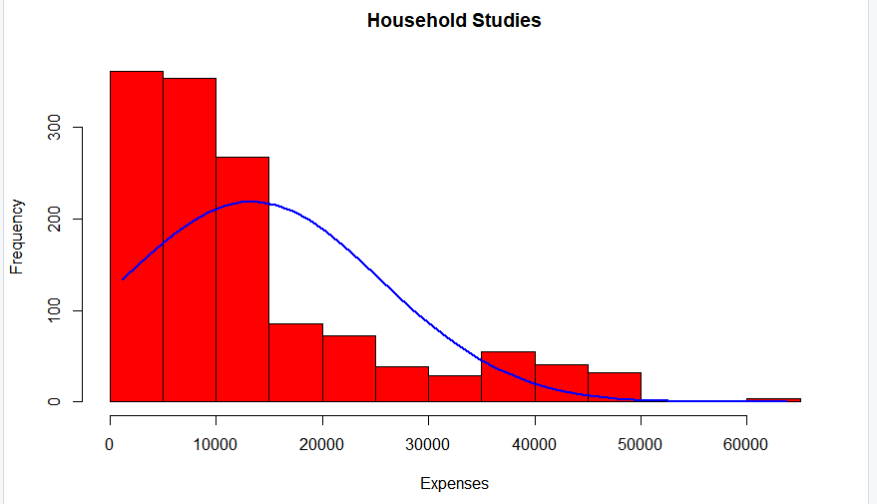
Histogram
Here, we can observe that the majority of the expenditure data are between 0 and 15,000, after which the expense graph decreases. Additionally, the Frequency high is around 350 and the low is almost 30. The histogram shows that the graph is positively skewed.

Slide 5
T - Test
Hypothesis Statement:
Here, we examine, our model with a null and alternative hypothesis with a 0.05 significance level.
HYPOTHESIS STATEMENT
Null Hypothesis
H0:β = 15000, The mean of the household expense is 15000.
Alternative Hypothesis
Ha:β ≠ 15000, The mean of the household expenses is not equal to 15000.

Slide 6
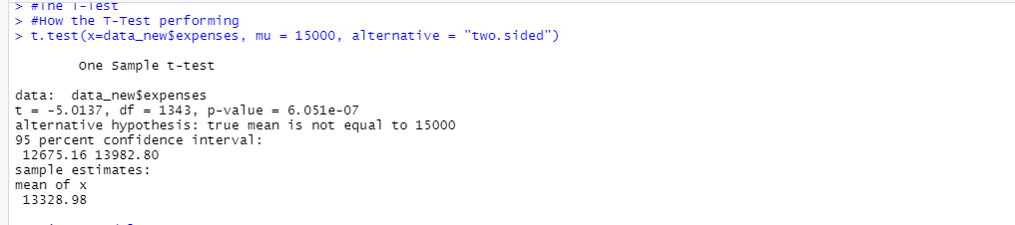
T- Test
Here, we see the t-test results, showing that the p-value is 6.051e-07. Therefore, it is well below the significance level.
As a result, we support the alternative hypothesis, which states that the household cost mean is not equal to $15,000 and rejects the null hypothesis.

Slide 7
Linear Regression Model
Hypothesis Statement:
Here, we examine, our Linear Regression Model with a null and alternative hypothesis with a 0.05 significance level.
HYPOTHESIS STATEMENT
Null Hypothesis
H0:β =0, Smoker’s coefficient is equal to zero and not statistically significant.
Alternative Hypothesis
Ha:β ≠ 0, Smoker’s coefficient is not equal to zero and is statistically significant.

Slide 8
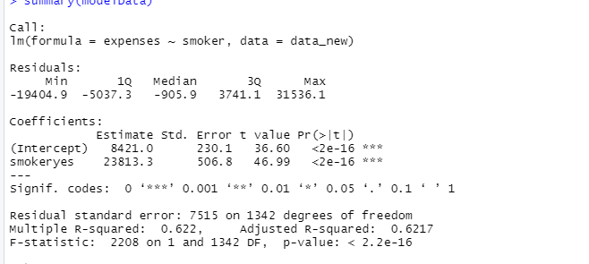
Linear Regression Model
The p-value for the findings of the linear regression model in this instance is 2.2e-16, which denotes that they are significantly below the 5% level of significance. This suggests that Smoker's coefficient is not equal to zero and is statistically significant, and we reject the null hypothesis.
Additionally, we see a pattern in the distribution where the median is larger than the mean, indicating a positively skewed distribution.
So, we can say that there is a relationship between smokers and expenses.

Slide 9
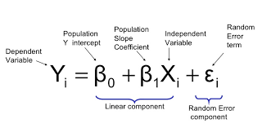
Linear Regression Model
the Regression Model Equation For a smoker
Y= 8421 + (23813) * X + error
Y= Expenses, X=smoker
If the person not smoking, then y =8421+23813*8421

Slide 10
Linear Regression Model
Residuals: The section provides a summary of the residuals and the difference between the model's forecast and the actual findings. Better residuals are smaller ones. So, here min is -19404.9, the lower quartile is -5037.3, the median is -905.9, the upper quartile is 3741.1 and the high level of the box plot is 31536.1.
Coefficients(Estimate): - The nonsmokers estimated expense of the household is much lower than smoking people who smoke. it is 23813 which is more than 1.5 times.
Residuals have also had a high variance were 7515 on 1342 observations.
The multiple R-squared value for the model is 0.6217. The value between 0 and 1 used to determine the model prediction and performance is extremely close to the model so our model performance is just fine.
The summary results reveal a t-value of 46.99. The big t-value indicates that the model is significant.

Slide 11
Multivariate Linear Regression
Hypothesis Statement:
Here, we examine, our Multivariate Regression Model with a null and alternative hypothesis with a 0.05 significance level.
HYPOTHESIS STATEMENT
Null Hypothesis
H0:β =0, All predictor variables are not correlated with the dependent variable.
Alternative Hypothesis
Ha:β ≠ 0, All predictor variables are correlated with the dependent variable.
β= Age, Sex, Bmi, Children, smoker, region.

Slide 12
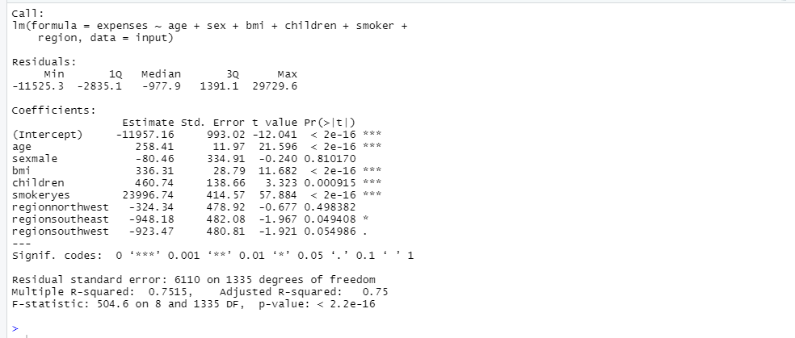
Multivariate Linear Regression
The p-value for the findings of the linear regression model in this instance is 2.2e-16, which denotes that they are significantly below the 5% level of significance. This suggests that independent variables are not equal to zero and are statistically significant, and we reject the null hypothesis. so, that means independent variables are related to dependent variables.

Slide 13
Multivariate Linear Regression
Equation of Multivariate Regression Model:
yi = B0 + B1xi1 + B2xi2 + ... + Bpxip + E where i = 1,2, ..., n
So,
Y = -11957.16 + 258.41 * age – 80.46 * sex + 336.31 * BMI + 460.74 * children + 23996.74 * smoker - 324.34 * region northwest- 948.18 * region southeast - 923.47 * region southwest
expenses = -11957.16 + 258.41 * 30 - 80.46 * 1 + 336.31 * 20 + 460.74 * 2 + 23996.74 * 1 - 324.34 * 1 - 948.18 * 0 - 923.47 * 0 = $7,065.72

Slide 14
Multivariate Linear Regression
Residuals: The section provides a summary of the residuals and the difference between the model's forecast and the actual findings. Better residuals are smaller ones. So, here min is -11525.3, the lower quartile is -2835.1, the median is -977.9, the upper quartile is 1391.1 and the high level of the box plot is 29729.6.
Residual Standard Error: Based on the findings, we have an error of 6110 on 1335 records, which suggests that the average difference between predicted and actual values for the multivariate linear regression model is rather significant.
The Adj. R-squared value for the model is 0.75. The value between 0 and 1 used to determine the model prediction and performance is extremely close to the model so our model performance is good.

Slide 15
Conclusion
In this case, I evaluate that the linear model results in the relationship between two variables, which would be fine, but not for this sort of dataset where you have several variables and must determine their associations. I believe multivariate linear regression to be a reasonable option for this investigation. Additionally, the Multivariate Regression Model performs well based on its Adj. R-square value, which is greater than that of the Linear Regression Model.

Slide 16
Thank You

